Slide 1



PYTHON STRINGS

Slide 2
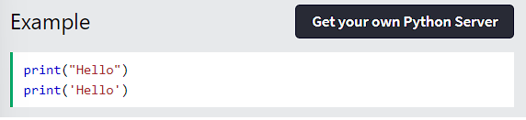
STRINGS
Strings in python are surrounded by either single quotation marks, or double quotation marks.
'hello' is the same as "hello".
You can display a string literal with the print() function:
Python - Strings

Slide 3
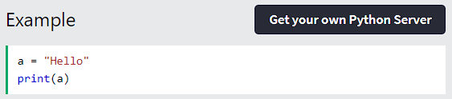
ASSIGN STRING TO A VARIABLE
Assigning a string to a variable is done with the variable name followed by an equal sign and the string:
Python - Strings

Slide 4
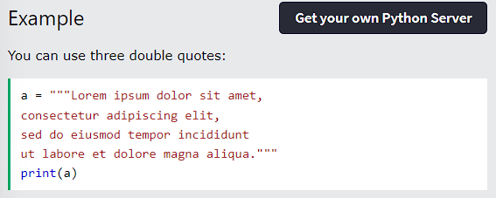
MULTILINE STRINGS
You can assign a multiline string to a variable by using three quotes:
Python - Strings

Slide 5
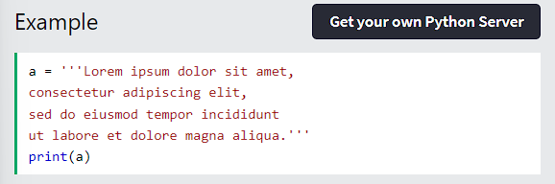
MULTILINE STRINGS
Or three single quotes:
Python - Strings

Slide 6
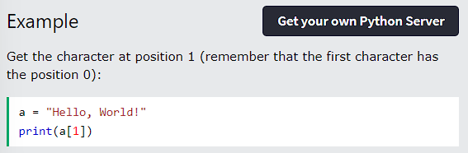
STRINGS ARE ARRAYS
Like many other popular programming languages, strings in Python are arrays of bytes representing unicode characters.
However, Python does not have a character data type, a single character is simply a string with a length of 1.
Square brackets can be used to access elements of the string.
Python - Strings

Slide 7
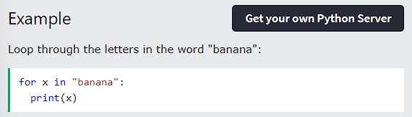
LOOPING THROUGH A STRING
Since strings are arrays, we can loop through the characters in a string, with a for loop.
Python - Strings

Slide 8
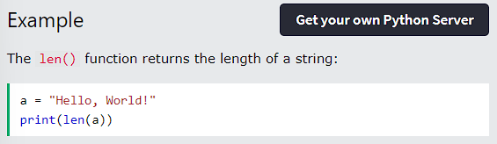
STRING LENGTH
To get the length of a string, use the len() function.
Python - Strings

Slide 9
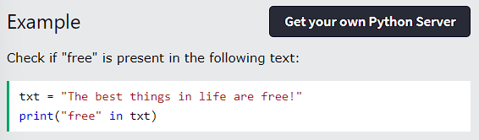
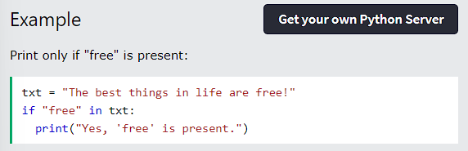
CHECK STRING
To check if a certain phrase or character is present in a string, we can use the keyword in.
Use it in an if statement:
Python - Strings

Slide 10
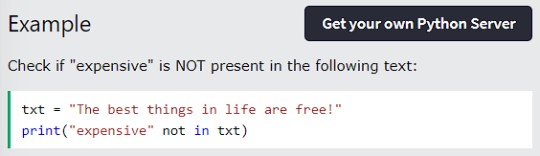
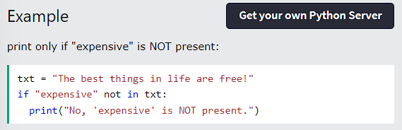
CHECK IF NOT
To check if a certain phrase or character is NOT present in a string, we can use the keyword not in.
Use it in an if statement:
Python - Strings

Slide 11
THANK YOU

Slide 12
PYTHON
MODIFY STRINGS
Python has a set of built-in methods that you can use on strings.

Slide 13
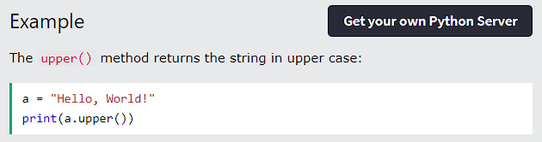
UPPER CASE
Python - String - Modify Strings

Slide 14
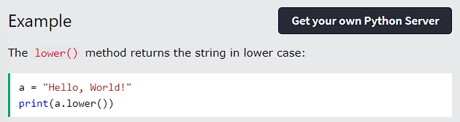
LOWER CASE
Python - String - Modify Strings

Slide 15
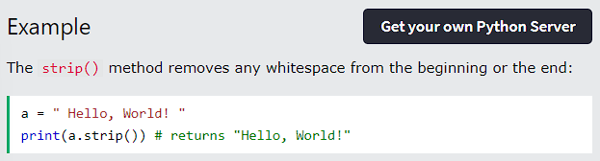
REMOVE WHITESPACE
Whitespace is the space before and/or after the actual text, and very often you want to remove this space.
Python - String - Modify Strings

Slide 16
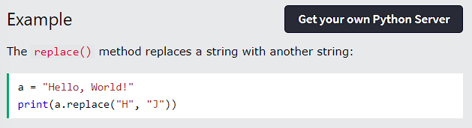
REPLACE STRING
Python - String - Modify Strings

Slide 17
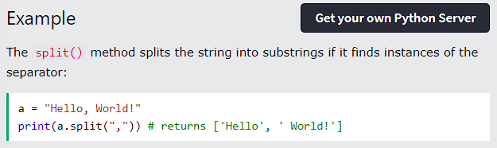
SPLIT STRING
The split() method returns a list where the text between the specified separator becomes the list items.
Python - String - Modify Strings

Slide 18
THANK YOU

Slide 19
PYTHON
SLICING STRINGS

Slide 20
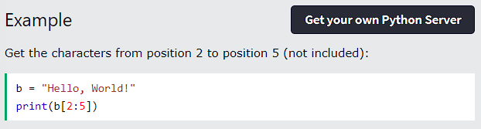

PYTHON - SLICING STRING
SLICING
You can return a range of characters by using the slice syntax.
Specify the start index and the end index, separated by a colon, to return a part of the string.
Python - String - Slicing Strings

Slide 21
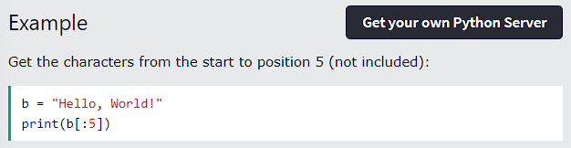
PYTHON - SLICING STRING
SLICE FROM THE START
By leaving out the start index, the range will start at the first character:
Python - String - Slicing Strings

Slide 22
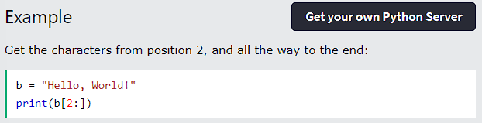
PYTHON - SLICING STRING
SLICE TO THE END
By leaving out the end index, the range will go to the end:
Python - String - Slicing Strings

Slide 23
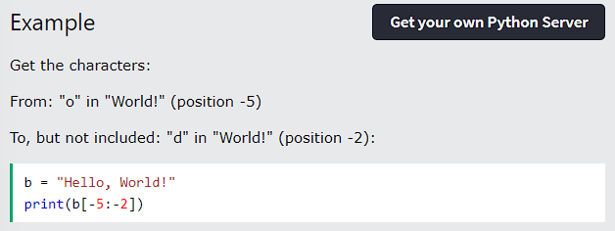
PYTHON - SLICING STRING
NEGATIVE INDEXING
Use negative indexes to start the slice from the end of the string:
Python - String - Slicing Strings

Slide 24
THANK YOU

Slide 25
PYTHON
STRING CONCATENATION

Slide 26
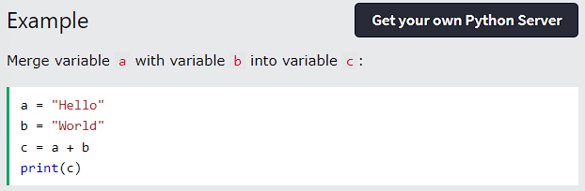
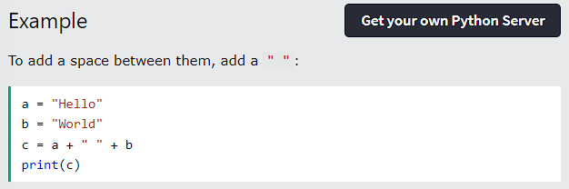
PYTHON - STRING CONCATENATION
STRING CONCATENATION
To concatenate, or combine, two strings you can use the + operator.
Python - String - String Concatenation

Slide 27
THANK YOU

Slide 28
PYTHON
FORMAT STRINGS

Slide 29
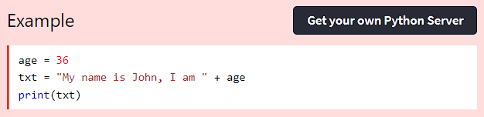
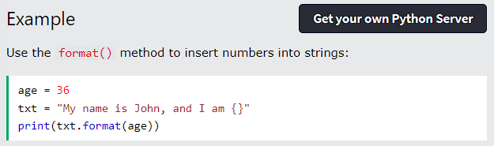
STRING FORMAT
But we can combine strings and numbers by using the format() method!
The format() method takes the passed arguments, formats them, and places them in the string where the placeholders {} are:
As we learned in the Python Variables chapter, we cannot combine strings and numbers like this:
Python - String - format Strings

Slide 30
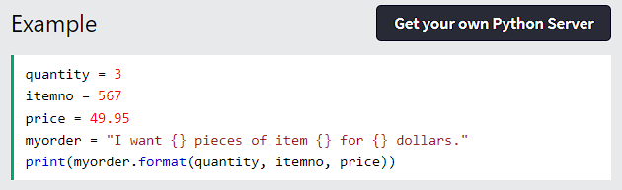
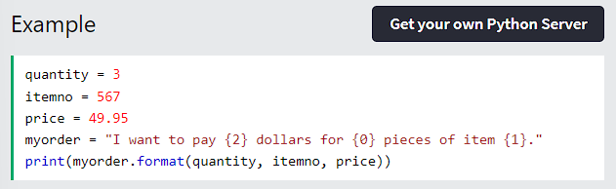
STRING FORMAT
The format() method takes unlimited number of arguments, and are placed into the respective placeholders:
You can use index numbers {0} to be sure the arguments are placed in the correct placeholders:
Python - String - Format Strings

Slide 31
THANK YOU

Slide 32
PYTHON
STRING EXERCISES

Slide 33
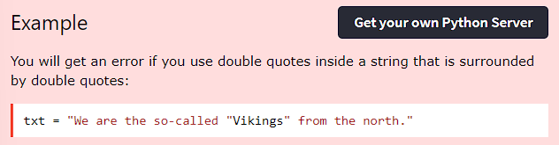
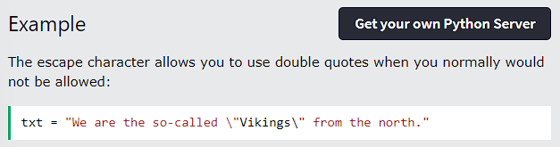
PYTHON - ESCAPE CHARACTERS
ESCAPE CHARACTER
To insert characters that are illegal in a string, use an escape character.
An escape character is a backslash \ followed by the character you want to insert.
An example of an illegal character is a double quote inside a string that is surrounded by double quotes:
To fix this problem, use the escape character \":
Python - String - Escape Characters

Slide 34
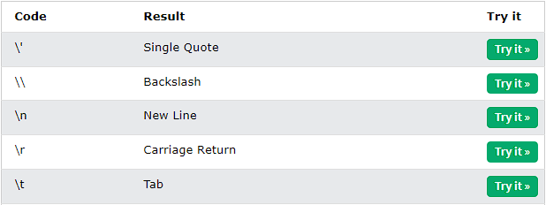
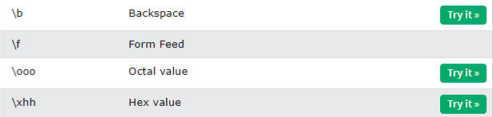
PYTHON - ESCAPE CHARACTERS
ESCAPE CHARACTERS
Other escape characters used in Python:
Python - String - Escape Characters

Slide 35
THANK YOU

Slide 36
PYTHON
STRINGS METHOD

Slide 37
STRING METHOD
Python has a set of built-in methods that you can use on strings.
Python - String - String Method

Slide 38
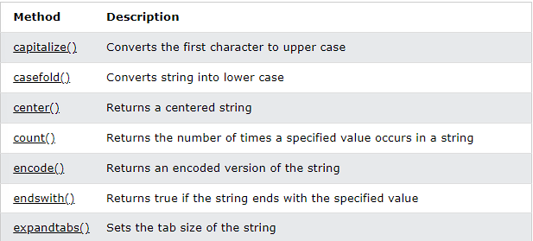
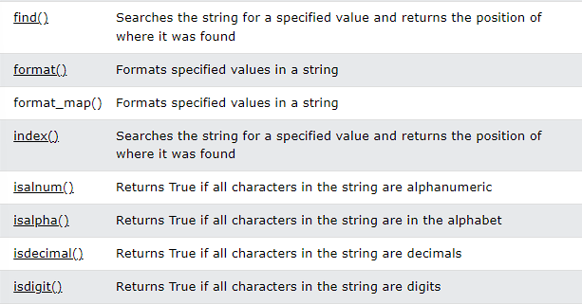
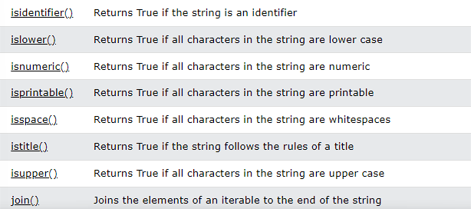
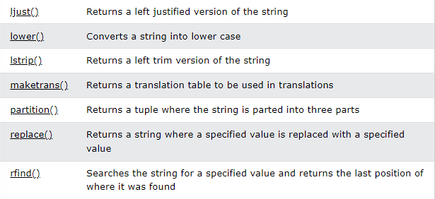
STRING METHOD
Python - String - String Method

Slide 39
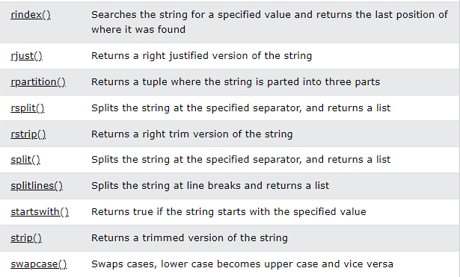
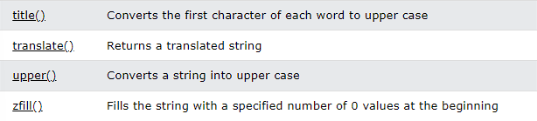
STRING METHOD
Python - String - String Method

Slide 40
THANK YOU

Slide 41
PYTHON
ESCAPE CHARACTERS

Slide 42
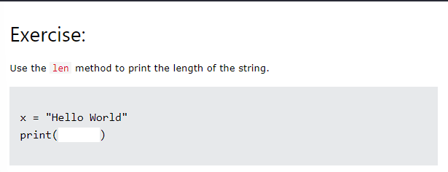
PYTHON - STRING EXERCISES
TEST YOURSELF WITH EXERCISES
Now you have learned a lot about Strings, and how to use them in Python.
Are you ready for a test?
Try to insert the missing part to make the code work as expected:
Python - String - Strig exercises

Slide 43
THANK YOU

